Slide 1

Using Python for world domination
Lesson 1.

Slide 2
Creating your minecraft mod
The first thing you will need is a directory to store your mod in and a copy of the Minecraft library files.
Run the following line on the pi to create a directory:
mkdir ~/yournamehere
Now run the following line to create a copy of the Minecraft files:
cp -r ~/mcpi/api/python/mcpi ~/yournamehere/minecraft

Slide 3
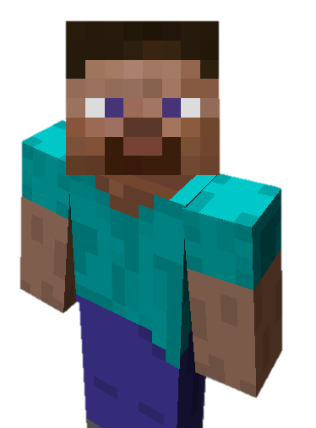
Creating your minecraft mod
Now open Python IDLE (not IDLE3!) and create a new program. This is where you will be writing your mod code.
You will need to import three library files at the start of your code. Annotate your code to explain what each does.
import minecraft as minecraft
import block as block
import time
Create a new slide here and put a screenshot of your annotated code on it.

Slide 4
Creating your minecraft mod
After importing the library modules, you will need to create a new instance of minecraft in your code.
In your annotation, describe what is meant by an instance. Why not just have one?
mc = minecraft.Minecraft.create()
mc.postToChat("Hello Steve.")
time.sleep(5)
Create a new slide here and put a screenshot of your annotated code on it.

Slide 5
Where’s Steve?
If you’re going to create something, it’s useful to do it in part of the world that you’re standing in. Save your code as ‘MinecraftL1_YourName.py
playerPos = mc.player.getPos()
mc.postToChat("Your postion is: " +
str(playerPos.x) + ", " +
str(playerPos.y) + ", " +
str(playerPos.z)) // all these on 1 line
time.sleep(5)
Create a new slide here and add a screenshot of your annotated code and an image of your code running on the pi. (you may want to use a photo)
Explain what the co-ordinates mean.

Slide 6
Where’s Steve?
Minecraft is nothing if you can’t create things, so let’s use some code to create a stack of blocks.
for up in range (0,20):
mc.setBlock(playerPos.x +1, playerPos.y +
up, playerPos.z, block.GOLD_BLOCK)// 1 line
time.sleep(2)
Create a new slide here and add a screenshot of your annotated code and an image of your code running on the pi. (you may want to use a photo)
Explain why we have used a FOR loop in the code.

Slide 7
Important Commands
sudo reboot - restarts the pi
pi – username
raspberry - password
startx – boots to desktop
cd mcpi – gets the minecraft directory
./minecraft-pi - boots minecraft

